Slide 1
Onestop
UNDER THE GUIDENCE OF PROF. SAMRIN PRABEKAR

Slide 2
PARTICIPANTS
NAME | ROLL NO. | DIVISION
Adishree Korpe | 329 | S.E(AI&DS)
Amish Koli | 327 | S.E(AI&DS)
Anaika Mahanta | 331 | S.E(AI&DS)

Slide 3
ABSTRACT
The front-end of the One Stop website is carefully crafted using HTML and CSS.
For the back-end we will utilize javascript , leveraging its robust framework and tools to build a and secure sever-side application.
These websites offer users a convenient, accessible, and personalized shopping experience, while enabling small businesses to reach a global audience.

Slide 4
INTRODUCTION
In today’s competitive online shopping environment, users often face issues like confusing navigation, slow page load times, and lack of clear information. To address these challenges, we designed OneStop with a focus on creating a user-friendly and efficient shopping experience.
Constructed with an emphasis on user experience and scalability, this platform showcases how contemporary technologies can be used to develop a smooth online shopping experience.
This project demonstrates the incorporation of necessary e-commerce features like user sign-up, product browsing, cart management, secure payment, and order monitoring.

Slide 5
LITREATURE SURVEY
TITLE | YEAR | AUTHOR | LIMITATIONS | METHODOLOGY
A Review Paper on E-Commerce | 2016 | Shahid Amin Bhat, K. Kansana, J.M. Khan | The study is conceptual in nature and raises opportunities for future research. | The study draws on previous research to identify key variables that contribute to the success of e-commerce, including consistency of transaction steps, replacement guarantee, M-Commerce services, and more.
Research on E-commerce Platform of Online Shopping Consumers | 2021 | Yidan Wang | The analysis of specific gender and age groups is more subjective. The research did not do more detailed research on specific products such as phone or beauty products to better understand what factors drive consumers to buy. | The research used a questionnaire survey to collect data from 580 respondents. The respondents were randomly selected and included different types of users, including young, middle-aged, and older users, as well as male and female users.

Slide 6
EXISTING SYSTEM
Here are some popular alternatives to ONESTOP for online shopping:
eBay: A global e-commerce platform for buying and selling goods, including auctions and direct purchases
Walmart: Offers a wide range of products online, often with competitive prices and fast delivery options.
Alibaba: Ideal for wholesale purchases, Alibaba caters to businesses and individuals looking for bulk deals.
Flipkart: A leading e-commerce site in India, offering a variety of products similar to Amazon.
Myntra: Known for quality products and deals, with online shopping.

Slide 7
PROBLEM STATEMENT AND 0BJECTIVES
The rapid growth of e-commerce has heightened customer expectations for seamless, fast, and personalized online shopping experiences. However, many businesses and developers face challenges in building a platform that replicates the features of leading e-commerce giants like Amazon. These challenges include implementing efficient product search functionalities, secure payment gateways, personalized recommendations, and scalable cloud infrastructure. This project aims to develop an Amazon-like website that addresses these issues by providing a user-friendly interface, reliable transaction processes, and scalable solutions for a variety of products and services . We are creating a platform to promote homegrown products and small businesses, providing them with the visibility and support they deserve but often lack. Our goal is to empower local entrepreneurs and foster a community that values quality and sustainability . The objective of the e-commerce website is to drive online sales by providing a seamless and user-friendly shopping experience. This includes intuitive navigation, personalized recommendations, and easy checkout options to enhance customer satisfaction.

Slide 8
PROPSED SYSTEM
The proposed E-commerce website aims to provide a seamless and user-friendly shopping experience by utilizing a clean and responsive design built with HTML and CSS. The system will be designed to offer a comprehensive product catalog, easy navigation, and secure transaction processing to enhance user engagement and satisfaction.
UI Design: Clean, responsive, and easy-to-navigate layout showcasing products, promotions, and categories.
Product Pages: High-quality images, detailed descriptions, pricing, and customer reviews for each product.
3. User Accounts: Login, sign-up, and guest checkout options for flexible shopping.

Slide 9
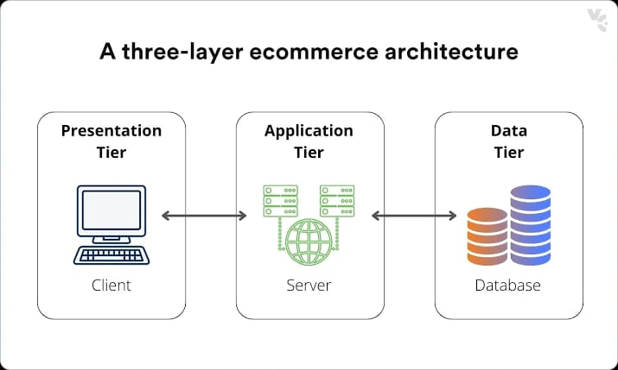
SYSTEM ARCHITECTURE

Slide 10
IMPLEMENTATION DETAILS
Design: Create wireframes and mock ups.
Features: Hero section, product categories, featured products, search bar, navigation menu, and footer Technologies: HTML: Structure content
CSS: Style the page .
JavaScript: Add interactive elements (e.g., sliders). Content: Use high-quality images and clear, engaging text. Include call-to-action buttons.
Responsive Design: Ensure the page works on all devices with media queries
Interactive Elements: Implement hover effects.

Slide 11
REFERENCES
You Tube channel: Apna college
https://youtube.com/@apnacollegeofficial?si=BkypulemAO3Q5e25
Research gate
https://www.researchgate.net

Slide 12
THANK YOU!

